Slide 1



Vue.js Essential Training
Trainer: Lionel
Website:www.tertiarycourses.com.sg
Email: enquiry@tertiaryinfotech.com

Slide 2


About the Trainer
Partner and Tech Lead of Wesvault Premium Software Development CTO, Consultant Lead to MNCs SAP - Leads teams of 2-3 people for premium projects - 15 Years in Software Dev
- Vue.js Singapore Exco member - BSc(mathematics) & CAIA, UWA (Aus) - PHP Yii2 expert, Vue.js and Python
- linkedin: lionel_yeo - github: auzadventure

Slide 3
Material
https://github.com/auzadventure/vue-beginner

Slide 4
Agenda
Module 1 - Get Started on Vue JS
What is Vue JS
Install Vue JS Libraries
Your First Vue JS Script
Element, Data and Methods
Computed Property
Instance Life Cycle
Module 2 - Directives
What are Directives
Attribute Binding with v-bind
Form Input with v-model
Watch Property
Conditional Display with v-show
Conditional Rendering with v-if
List Rendering with v-for
Event Handling with v-on

Slide 5
Agenda
Module 3 - Components
What is Component
Create Component
Data and Props
Child Components
Module 4 - Vue Cli and Router
Vue Router
Module 5 - Transition (Optional)
Transition Classes

Slide 6
Prerequisites
The following basic knowledge are assumed in this training:
HTML
CSS
JavaScript

Slide 7

IDE
You will use Visual Studio Code for this training.
You can download Visual Studio Code from
https://code.visualstudio.com/download

Slide 8
Exercise files
Please download the exercise files from
https://github.com/tertiarycourses/VueJSTraining

Slide 9
Module 1
Overview of Vue JS

Slide 10



Javascript Frameworks for Web
Javascript frameworks for Web shift the some of heavy lifting tasks, traditionally done by server scripting language such as PHP, from server to browser
There are 3 main Javascript frameworks for web:

Slide 11
Why Vue JS
VueJS is a progressive JavaScript framework used to develop interactive web interfaces.
Vue JS are preferred due to:
Easy to Use. Vue JS does not use Typescript and ES6
Fast and Lightweight
Reusable Components
Scalable

Slide 12

History of Vue JS
Vue was created by Evan You after working for Google using AngularJS in a number of projects
Vue was originally released in February 2014.

Slide 13
Install Vue JS Libraries
To install Vue JS libraries on client applications, add the following javascript on the head section of your HTML file
<script src="https://unpkg.com/vue"></script>
Alternatively, you can download the vue.js file to your local computer
<script src="vue.min.js"></script>

Slide 14
Your First Vue Script
<div id="app">
<h1>{{ message }}</h1>
</div>
<script>
var vm = new Vue({
el: '#app',
data: {
message: 'Hello World'
}
})
</script>

Slide 15
Vue Instance
To start with VueJS, we need to create the instance of Vue
var vm = new Vue({
// options
})
el assign the id of the DOM element
data object assign the data
{{}} will replace the value assigned in the data object

Slide 16
Ex: Data
Add the following data and display them
Name
Gender
Hobby
Go to the console, and change the value of the Name
Time: 5 mins

Slide 17
Add More Vue Instance
You can add vue instance with a unique el
<script>
var vm = new Vue({
el: '#app2',
data: {
message: "Hello World 2"
}
})
</script>

Slide 18
Ex: Add Vue Instance
Move the gender in the previous exercise to a new instance
Time: 5 mins

Slide 19
Methods
You can add methods or functions to Vue instance with the methods object and call the function in the DOM.
methods: {
welcome : function() {
return "Hello " + this.name;
}
}
<div id="app">
<h1>{{ welcome() }}</h1>
</div>

Slide 20
Ex: Methods
Show the temperature in Celsius and Fahrenheit. Use Method to compute Fahrenheit
T(°F) = T(°C) × 9/5 + 32
Celsius: 30
Fahrenheit: 86
Time: 5 mins

Slide 21
Computed Property
Another attribute of Vue object is computed which allows you to create more complex data Eg
computed: {
welcome : function() {
return "Hello " + this.name;
}
}

Slide 22
Ex: Computed Property
Show the temperature in Celsius and Fahrenheit. Use Computed Property to compute Fahrenheit
T(°F) = T(°C) × 9/5 + 32
Celsius: 30
Fahrenheit: 86
Time: 5 mins

Slide 23
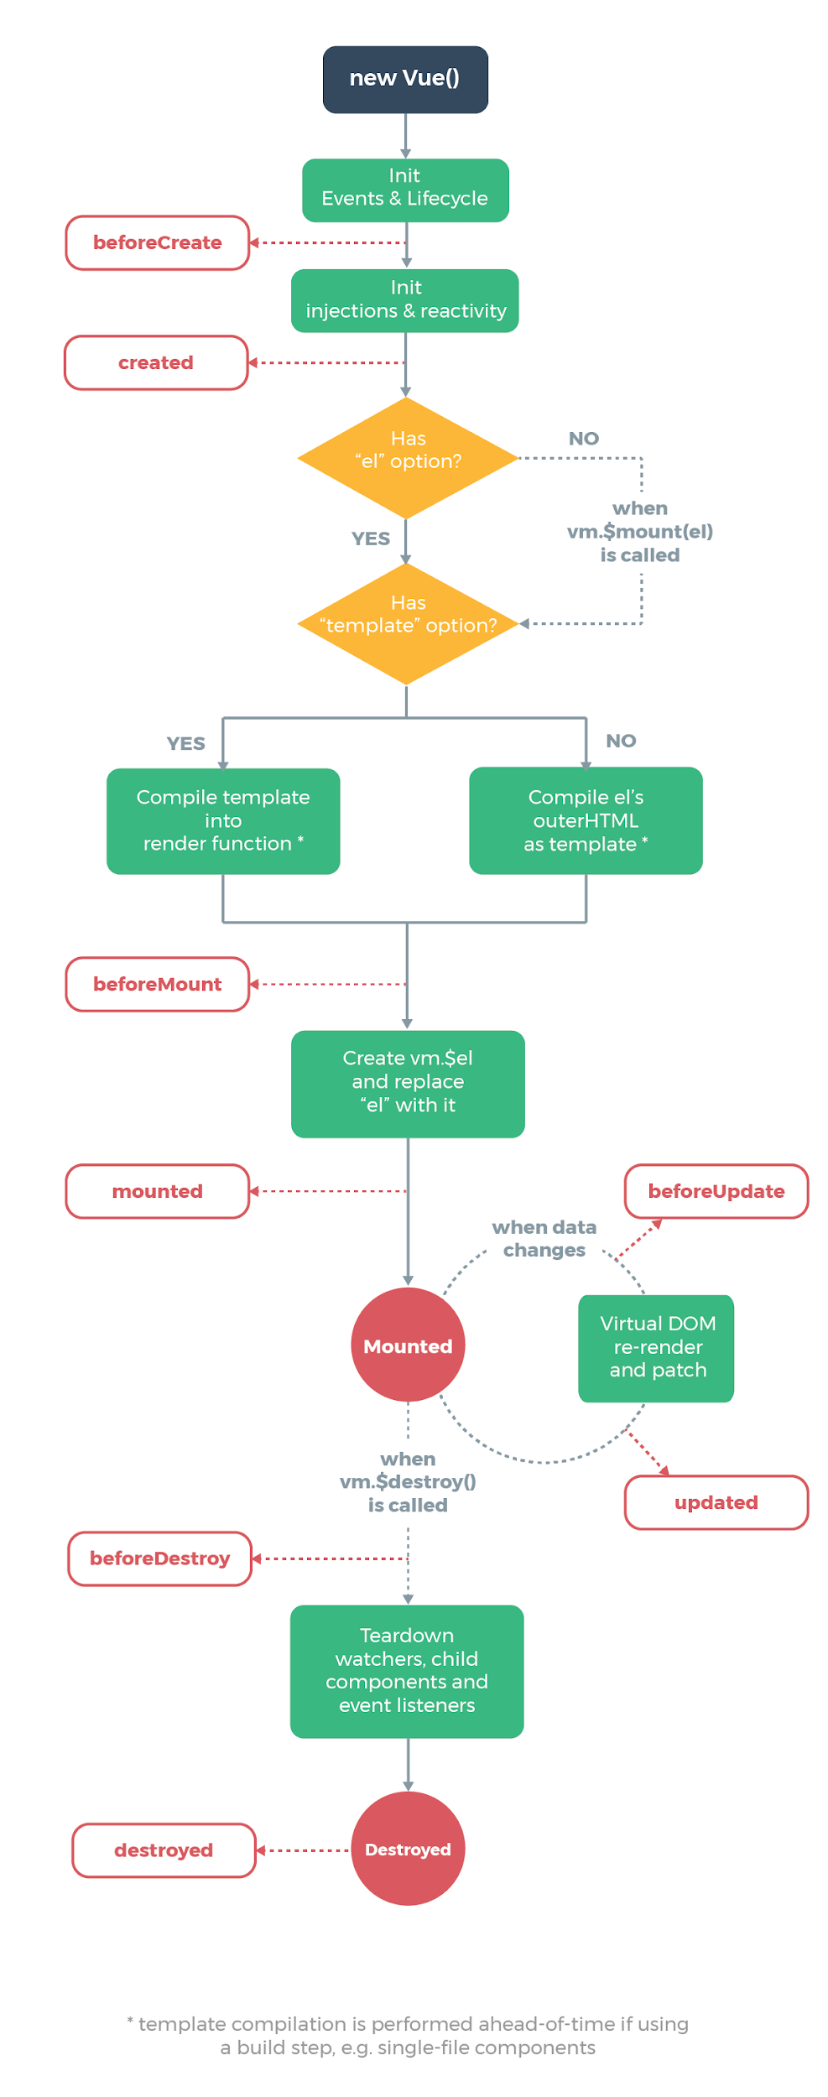
Instance Life Cycle
Each Vue instance goes through a series of initialization steps when it’s created - for example, it needs to set up data observation, compile the template, mount the instance to the DOM, and update the DOM when data changes.
Along the way, it also runs functions called lifecycle hooks, giving users the opportunity to add their own code at specific stages.

Slide 24
Created Hook
For example, the created hook can be used to run code after an instance is created:
var vm = new Vue({
el: '#app',
data: {
a: 1
},
created: function () {
console.log('a is: ' + this.a)
}

Slide 25
Module 2
Directives

Slide 26
Directives
Directives are instruction for VueJS to do things in a certain way
Directives are prefixed with v-
Example of directives
v-bind
v-model
v-for
v-show
v-if, v-else-if, v-else
v-on

Slide 27
v-bind
v-bind directive is used to reactively update an HTML attribute
It can take an “argument”, denoted by a colon after the directive name
Eg
Href v-bind:href
Input v-bind:value
Class v-bind:class
Title v-band:title

Slide 28
v-bind:title
Not working!
<div id="app">
<span title="message">
Hover your mouse over me for …. </span>
</div>
<div id="app">
<span title={{message}}>
Hover your mouse over me for …. </span>
</div>
Working!
<div id="app">
<span v-bind:title="message">
Hover your mouse over me for …. </span>
</div>

Slide 29
v-bind:href
Not working!
<a href={{link}} target = "_blank">Click 1 </a> <br/>
Working!
<a v-bind:href="url" target = "_blank">Click 2 </a> <br/>
<a v-bind:href="url + '?q=cat'">Search Cat</a>

Slide 30
v-bind shorthand
<!-- full syntax -->
<a v-bind:href="url + '?q=dog'">Search Dog</a>
<!-- shorthand -->
<a :href="url + '?q=dog'">Search Dog</a>

Slide 31
v-bind:value
Not Working!
<form>
Name : <input type='text' value={{name}}>
</form>
Working!
<form>
Name : <input type='text' :value="name">
</form>

Slide 32
v-bind:style
<div id="app">
<span v-bind:style="fancy"> Hello World!</span>
</div>
<script>
new Vue({
el: '#app',
data: {
fancy: {
backgroundColor: 'lightgrey',
borderRadius: '10px',
padding: '10px',
marginTop: '30px'
}
}
});
</script>

Slide 33
v-bind:class
For normal css styling using class, use boolean to bind to the class Eg
<div id="app">
<h1 :class='{salmon:salmon,pink:pink}'>{{welcome()}}</h1>
</div>
<script>
var vm = new Vue({
el: '#app',
data: {
name: 'Ally',
salmon: true,
pink: false
},
})
</script>

Slide 34
Ex: v-bind:class
Add one more yellow box for warm color
Time: 5 mins

Slide 35
v-model
v-model can do two-way data binding Eg
Name: <input type='text' v-model="name">
<p>Hello {{ name }}</p>

Slide 36
v-model Modifiers
Modifiers modify the behavior of the v-model.
There are 3 modifiers for v-model:
lazy - syncs the input with the data after change
number - automatically typecast as a number
trim - user input to be trimmed automatically

Slide 37
Lazy Modifier
Name: <input type='text' v-model.lazy = "name">
<p>Hello {{ name }}</p>

Slide 38
Ex: v-model
Capture the Celsius data from the input box.
Apply lazy and number modifiers
Update the Fahrenheit value
Celsius: 30
Fahrenheit: 86
Time: 5 mins

Slide 39
Ex2: v-model
Open module2_4b exercise, try to display the selected items using v-model
Hint:
<input type="checkbox" v-model="selectedInterests" value="Running"> Running
Time: 5 mins

Slide 40
Watch
Watch property in Vue provides a more generic way to observe and react to data changes on a Vue instance:
watch : {
kilometers:function(val) {
this.kilometers = val;
this.meters = val * 1000;
},
meters : function (val) {
this.kilometers = val/ 1000;
this.meters = val;
}

Slide 41
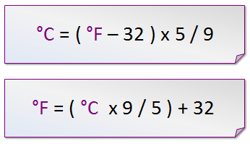
Ex: Watch
Use the watch property to convert Celsius to Fahrenheit and vice versa

Slide 42
v-for
v-for is used to looping through the items in an array Eg
<div v-for="i in 10">{{i}}</div>
<div v-for="i in interests">{{i}} </div>
<script>
var vm = new Vue({
el: '#app',
data: {
interests: ['Running','Cycling','Swimming']
}
})
</script>

Slide 43
Ex1: v-for
Using v-for to generate a list of fruits
fruits: ['apple','orange','banana','durian']
Hint:
<ul>
<li v-for="i in fruits">{{i}}</li>
</ul>
Time: 5 mins

Slide 44
Ex2: v-for
Re-do the previous exercise on interest checkbox with v-for
Hint:
<div v-for="interest in interests">
<input type="checkbox" v-model="selectedInterests" v-bind:value="interest">{{interest}}
</div>
Time: 5 mins

Slide 45
v-for with Index
You can get index from v-for Eg
<div v-for="(interest,index) in interests">
<input type="checkbox" v-model="selectedInterests" v-bind:value="interest.id">
{{index+1}}, {{interest.name}}
</div>

Slide 46
v-show
v-show only display the result if the condition is met
<ul>
<li v-show="hobby.length>1" v-for="i in hobby">{{i}}</li>
</ul>

Slide 47
Ex: v-show
From the previous exercise, only show the interest if there are one or more interests.
If there is no selection, show "Please select one of the interest"
Time: 5 mins

Slide 48
v-if, v-else and v-else-if
v-if and v-else allow more control than v-show.
<div id="app">
<span v-if="num > 4">You ate {{num}} durians. That is a lot</span>
<span v-else-if="num > 0">You ate {{num}} durians</span>
<span v-else>You have not eaten durian</span>
</div>
<script>
var vm = new Vue({
el: '#app',
data: {
num: 1
}
})
</script>

Slide 49
Ex: v-if-else
From the previous interest checkbox exercise,
if interests = 3, print"you must be very active"
else if interests == 0, print"please select at least one exercise
else show the interests
Time: 5 mins

Slide 50
v-on
v-on is to listen to the events in VueJS.
<button v-on:click="alert">Click here </button>
methods: {
alert: function() {
alert('You have pressed the button');
},

Slide 51
Ex: v-on
Create a Button "Show Answer". When click, it will show the sum of 2 numbers Eg
100 + 200 = 300
Time: 5 mins

Slide 52
v-on Shorthand
<!-- full syntax -->
<a v-on:click="doSomething"> ... </a>
<!-- shorthand -->
<a @click="doSomething"> ... </a>

Slide 53
Event Modifiers
Modifiers are special postfixes denoted by a dot, which indicate that a directive should be bound in some special way.
Some of the event modifiers are:
.stop
.prevent
.capture
.self
.once
.passive

Slide 54
Prevent Modifier
The event.preventDefault() method stops the default action of an element from happening. Eg
Prevent a submit button from submitting a form
Prevent a link from following the URL
<div id="app">
<form>
<button v-if="!loggedIn" v-on:click.prevent="logIn('Mike')"> Log in</button>
<button v-else v-on:click.prevent="logOut">Log out</button>{{msg}}
</form>
</div>

Slide 55
Module 3
Components

Slide 56
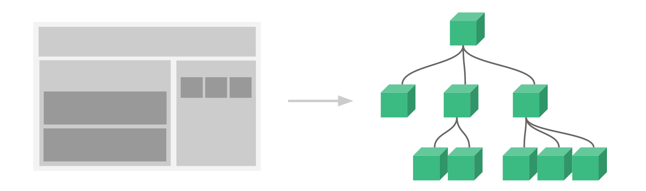
Component
Components are small pieces of UI, and put them together with other components to create an entire user interface.

Slide 57
Creating a Component
<div id="app">
<hello></hello>
<hello></hello>
<hello></hello>
</div>
<script>
Vue.component('hello', {
template: '<h1>Hello World</h1>'
})
var vm = new Vue({
el: '#app'
})
</script>

Slide 58
Ex: Component
Add a second component Welcome and render the following on the browser
Hello World
Welcome to Vue JS Training
Time: 5 mins

Slide 59
Slot
You can modify the output of a component using slot.
<div id="app">
<hello>Alfred</hello>
<hello></hello>
</div>
<script>
Vue.component('hello', {
template: '<h1>Hello <slot>name</slot></h1>'
})
var vm = new Vue({
el: '#app'
})
</script>

Slide 60
Data in Component
Since components are reusable Vue instances, they accept the same options as new Vue, such as data, computed, watch, methods, and lifecycle hooks.
However a component’s data option must be a function Eg
Vue.component('hello', {
data: function () {
return {
count: 0
}
},

Slide 61
Props
You can use props to pass data to a component Eg
<div id="app">
<welcome first_name="Alfred" last_name="Ang"></welcome>
</div>
<script>
Vue.component('welcome', {
props: ['first_name','last_name'],
template: '<h1> Hello {{ first_name }} {{last_name}}</h1>'
})
var vm = new Vue({
el: '#app'
})
</script>

Slide 62
Ex: Props
List the to-do items using component and props Hint:
Vue.component('todo-item', {
props: ['todo'],
template: '<li>{{ todo.text }}</li>'})
var app = new Vue({
el: '#app',
data: {
todoList: [
{ id: 0, text: 'Buy Groceries' },
{ id: 1, text: 'Buy Lunch' },
{ id: 2, text: 'Watch Movie' }
]
}
})

Slide 63
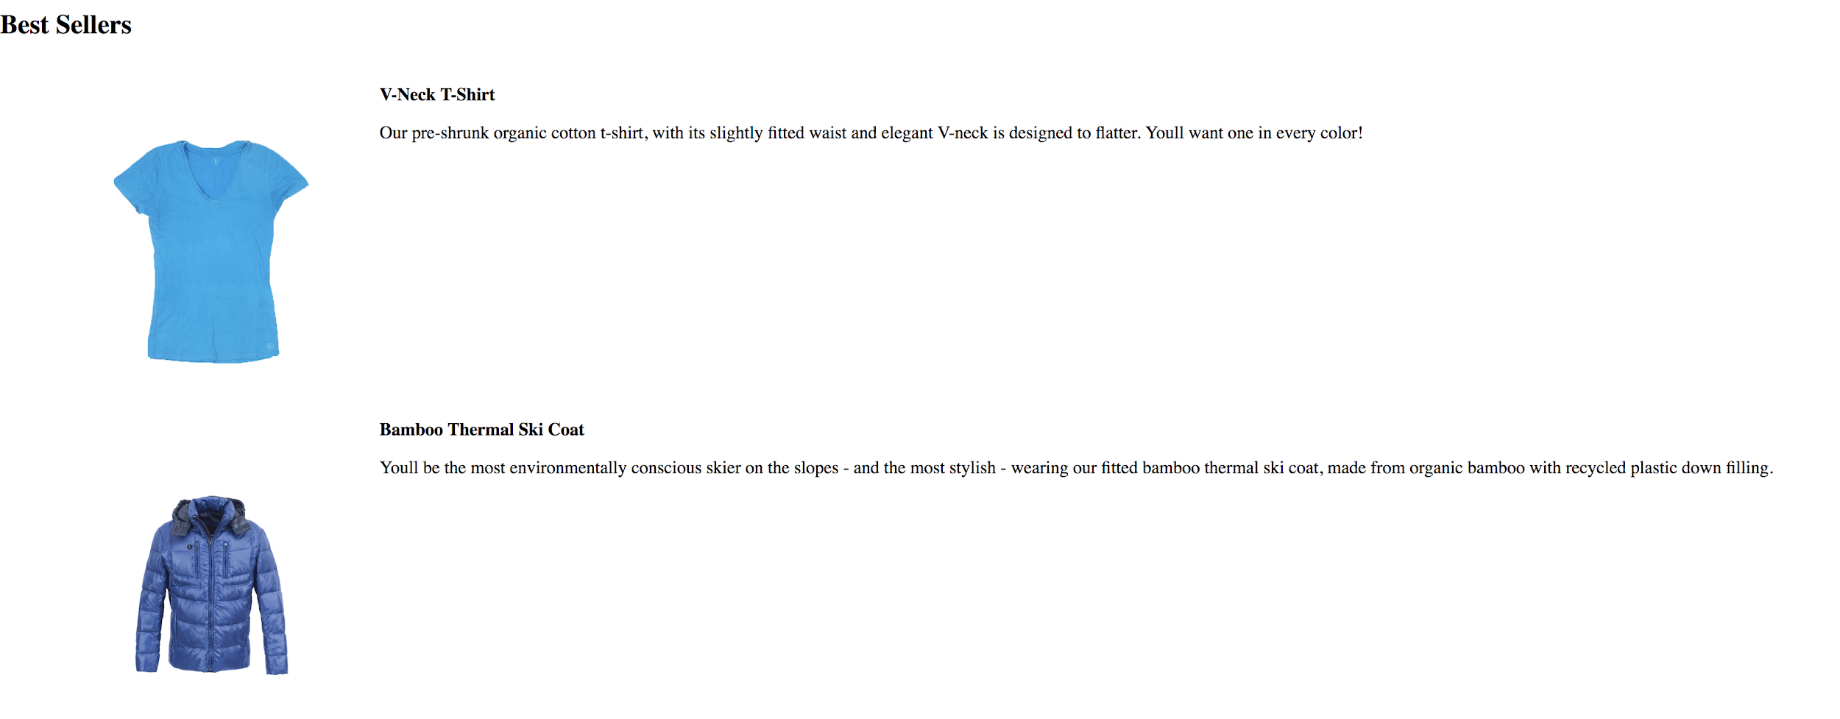
Case Study: Product List
Open module 3_5 to list products from API

Slide 64
Child Component
You can embed a component (child) into another component (parent)
The template must be start and end with <div> for the parent component
Vue.component('welcome', {
template: '<div>\
<hello></hello>\
<h1>Welcome to Vue JS Training</h1></div>'
})

Slide 65
Child Component Props
Props is used to pass data from parent component to child component
Vue.component('welcome', {
template: '<div>\
<hello first_name="Alfred" last_name="Ang" ></hello>\
<h1>Welcome to Vue JS Training</h1></div>'
})

Slide 66
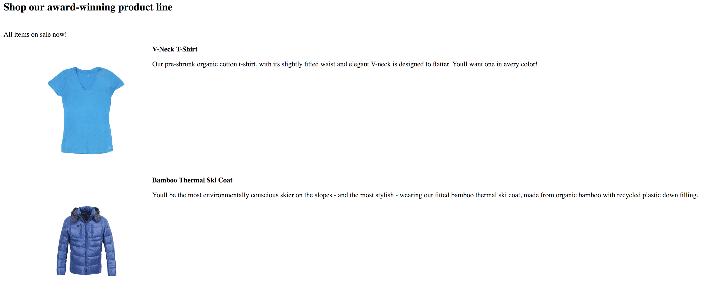
Case Study: Child Components
Open module 3_8 to list products from API using Children Components

Slide 67
Ex: Child Component Props
Create a parent component, grocery, and put the todo-item component into the grocery component: Hint
Vue.component('grocery', {
props: ['grocerylist'],
template: '<div>\
<h1>To Do List:</h1>\
<ol>\
<todo-item v-for="item in grocerylist" v-bind:todo="item" v-bind:key="item.id"></todo-item>\
</ol>\
</div>'
})

Slide 68
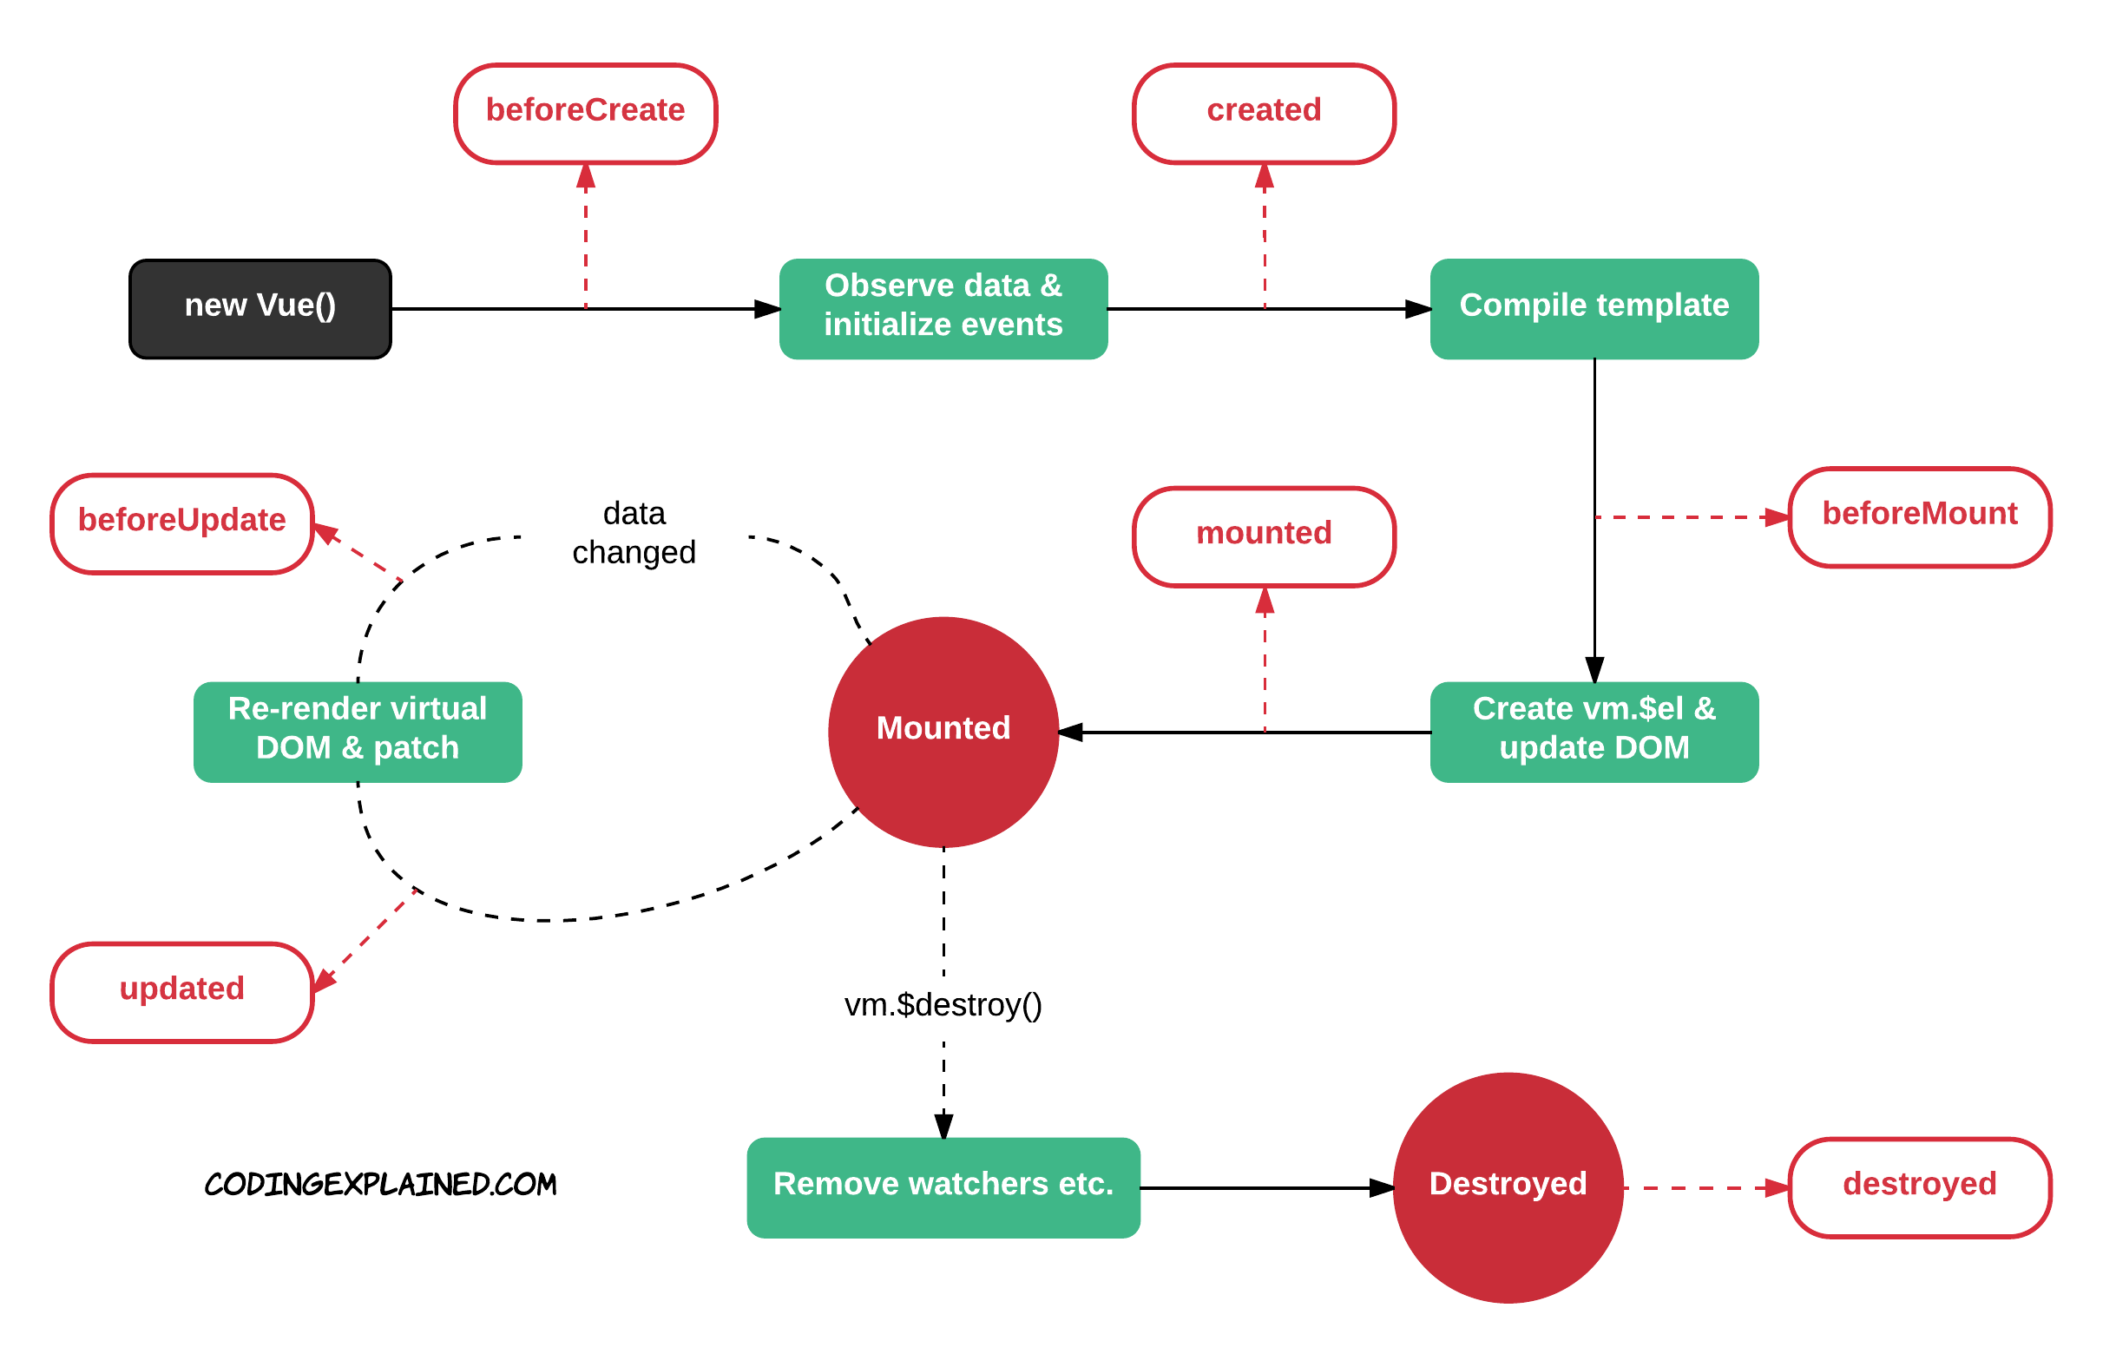
Component Life Cycle

Slide 69
Created
You can use the created key in component to define what happen when the component is created.
Vue.component('hello', {
created: function () {
alert('New component created')
}
})

Slide 70
Module 4
Vue Cli and Router

Slide 71
Vue Cli
Vue provides an official CLI for quickly scaffolding ambitious Single Page Applications
Vue Cli is a full system for rapid Vue.js development platform. It allows you to create Vue App can also be deployed on the server
Vue Cli is based on node.js

Slide 72
Installing Node JS
Download and Install Node JS https://nodejs.org/en/download/
To test if Node JS was installed successfully type the following commands on your Windows CMD Prompt / Mac Terminal
node -v
To test if Node Package Manager (NPM) was installed successfully, type
npm -v

Slide 73
Install Vue CLI
To install Vue CLI, type the following command to your Windows CMD Prompt or Mac Terminal
npm install -g vue-cli

Slide 74
Create Vue Project
To create Vue project, type the following command to your Windows CMD Prompt or Mac Terminal:
vue init webpack myapp
cd myapp
npm run dev

Slide 75
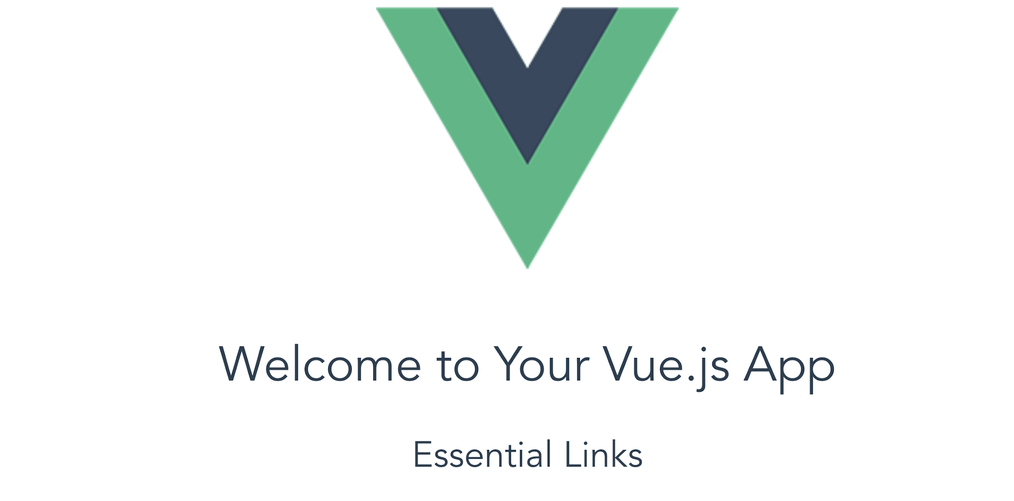
Vue App
View on the browser http://localhost:8080/

Slide 76
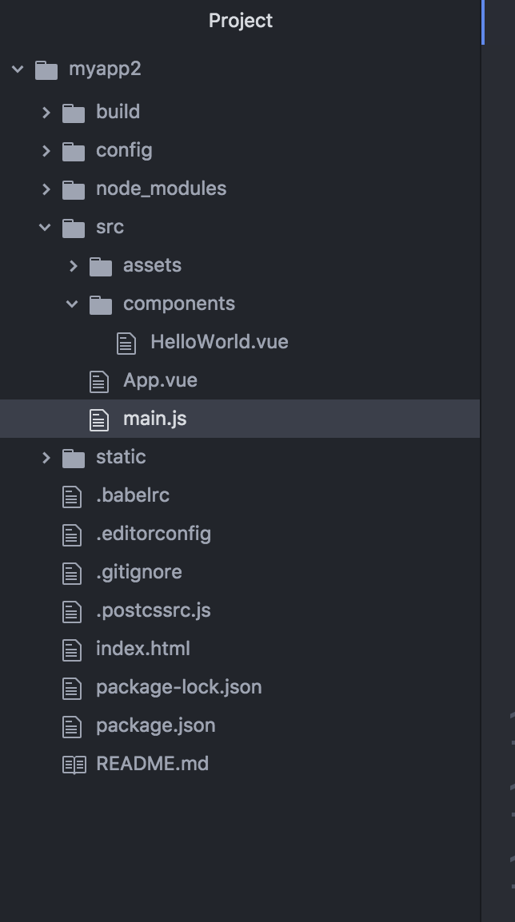
Vue App Structure
The main.js will call the main component App.vue
App.vue component consist of the subcomponents
Each component has template, script and style

Slide 77

Ex: Vue App
Create a new Vue app, and change the text to below

Slide 78
Single Page Applications
Using SPA there is no need to refresh the page every time we make a request to the server
Vue Router helps us create SPA

Slide 79
Installing Vue Router
To install the vue router libraries, add the following javascript on the head section of your HTML file
<script src="https://unpkg.com/vue-router"></script>

Slide 80
Router Link
<router-link> is a component used to navigate to the HTML content to be displayed to the user. The to property is the destination
<p>
<router-link to = "/route1">Router Link 1</router-link>
<router-link to = "/route2">Router Link 2</router-link>
</p>

Slide 81
Templates
You can define constants for the templates of each route
const Route1 = { template: '...' }
const Route2 = { template:' …'}

Slide 82
Route Path
You can define the constant to match the URL to each routes
const routes = [
{ path: '/route1', component: Route1 },
{ path: '/route2', component: Route2 }
];

Slide 83
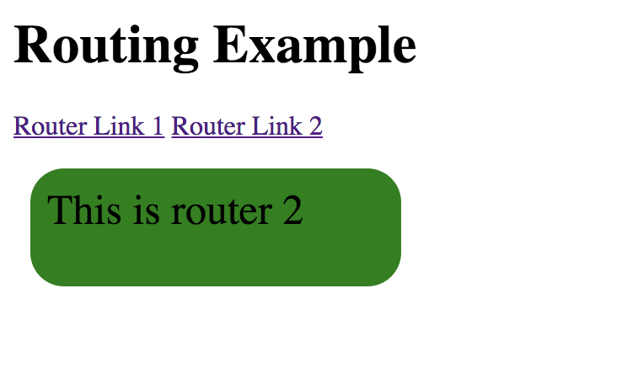
Router Instance
The VueRouter constructor takes the routes as the param
const router = new VueRouter({
routes: routes
});

Slide 84
Ex: Router
Add one more routes Route3 to the router demo
Time: 5 mins

Slide 85
Module 5
Transition (Optional)

Slide 86
Transition
Vue JS provides various ways to apply transition to the HTML elements when they are added/updated in the DOM
Vue JS has a built-in transition component that needs to be wrapped around the element, which needs transition

Slide 87
Apply Transition to an Element
<transition name="fade">
<p v-if="show">hello</p>
</transition>

Slide 88
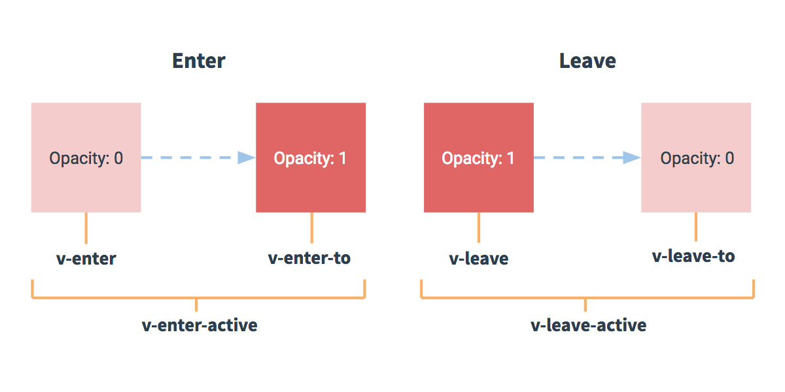
Transition States

Slide 89
Enter/Leave Transitions
There are six classes applied for enter/leave transitions.
v-enter: Starting state for enter
v-enter-active: Active state for enter.
v-enter-to: Ending state for enter
v-leave: Starting state for leave.
v-leave-active: Active state for leave
v-leave-to: Ending state for leave

Slide 90
Transition Control
<style>
.fade-enter-active, .fade-leave-active {
transition: opacity .5s;
}
.fade-enter, .fade-leave-to {
opacity: 0;
}
</style>

Slide 91

Summary
Q&A

Slide 92

Feedback
https://goo.gl/R2eumq

Slide 93
Thank You!
Lionel
lionel@wesvault.com

